Slide 1

"A Data-Driven Perspective on India's Renewable Energy Growth and Trends: Visualization and Time Series Analysis"
MBS6099 - MASTER THESIS
PROJECT REVIEW
Under the guidance of
Dr. Jitendra Kumar
(Associate Professor)
Presented By
Nedunuri Sai Srividya
22MBS0032

Slide 2
Table of Content
Relevance
Problem Statement
Abstract
Objectives
Literature Review
Methodology
Results and Conclusion
Future Scope

Slide 3
Relevance
Renewable energy is one of the most effective and sustainable alternative to the fossil fuels or non renewable energy.
Renewable energy is derived from naturally replenishing sources that are virtually inexhaustible over human timescales, such as sunlight, wind, water (hydro), biomass, and geothermal heat.
Renewable energy sources produce minimal or no greenhouse gas emissions during energy generation, unlike fossil fuels, which contribute to climate change and air pollution. They help reduce reliance on fossil fuels and mitigate environmental impacts.
Renewable energy encompasses a diverse range of technologies, including solar photovoltaic (PV) and solar thermal, wind turbines, hydropower plants, biomass combustion, geothermal power plants, and tidal energy systems.

Slide 4
Problem Statement
India stands 4th globally in Renewable Energy Installed Capacity (including Large Hydro), 4th in Wind Power capacity & 4th in Solar Power capacity .The country has set an enhanced target at the COP26 of 500 GW of non-fossil fuel-based energy by 2030.
India’s installed non-fossil fuel capacity has increased 396% in the last 8.5 years and stands at more than 179.57 GW (including large Hydro and nuclear), about 42% of the country’s total capacity (as of Nov 2023). India saw the highest year-on-year growth in renewable energy additions of 9.83% in 2022.
With the increasing integration of renewable energy sources like wind and solar into the power grid, accurate forecasting becomes crucial for efficient grid operation and energy management and the focus of this research is on implementing various time series models in order to check the performance and obtain better forecasts.

Slide 5
Abstract
The term "renewable energy" describes energy produced from naturally occurring resources, such as biomass, geothermal heat, wind, sunshine, and water (hydro). In contrast to fossil fuels, which are limited and release pollutants into the atmosphere and contribute to climate change when burned, renewable energy sources are thought to be sustainable and have negligible environmental effects.
The utilization of renewable energy sources is deemed essential in the fight against climate change and the shift to a more ecologically friendly and sustainable energy system. They have many advantages, including as lowering greenhouse gas emissions, improving energy security, generating employment, and fostering economic growth.
The report starts with a summary of the state of renewable energy in India, emphasizing investment patterns, regulatory measures, and technical developments that have impacted the sector's expansion in the last ten years. Visualization has been carried out to identify the growth and trends in various sources of renewable energy installation capacities and power generation in every state using PowerBi. In order to predict future patterns in renewable energy consumption, a variety of time series models are then used to the data, such as autoregressive integrated moving average (ARIMA),XGBoost and other techniques. This analysis is helpful in identifying the future scope of renewable energy in India and its contribution in the energy sector.
Key words: Renewable energy, Sustainability, Solar energy, Time series analysis, PowerBi.

Slide 6
Objectives
The main objective of this research is firstly to collect the state wise data about monthly generation of energy from renewable sources such as solar, wind, bio mass, small hydro etc and also the data about the installed capacities of energies in various states
Later visualize this data to gather insights about various states production of energy from renewable sources.
The second objective of this research is to forecast the monthly power generation for the coming periods in order to understand the future requirement or demand of the energy .
Various models of Time series analysis and Machine learning have been used for this forecasting.

Slide 7
Literature Review
Traditional forecasting methods often face challenges in handling the complex and nonlinear nature of renewable energy data. Deep learning, a subset of machine learning, has shown promise in addressing these challenges by automatically learning complex patterns and dependencies in data.
In a paper presented by Conor Sweeney, Ricardo J. Bessa, Jethro Browell, Pierre Pinson , the authors discussed the promising potential of machine learning models, including deep learning and neural networks, in capturing intricate spatiotemporal patterns within renewable energy data, thereby enhancing forecast accuracy for high-resolution data obtained from various sources like weather models, satellites, and IoT sensors
Another paper introduces the concept of multi-aspect renewable energy forecasting, which aims to enhance the accuracy and reliability of renewable energy forecasts by considering multiple relevant aspects simultaneously.

Slide 8
The authors, Roberto Corizzo, Michelangelo Ceci, Hadi Fanaee-T, and Joao Gama emphasize the importance of considering multiple aspects, including weather data, historical trends, and system dynamics, to improve forecasting performance.The paper explores various modeling approaches for multi-aspect renewable energy forecasting, including regression analysis, time series analysis, and ensemble methods.
In a paper presented by Michelangelo Ceci, Roberto Corizzo, Donato Malerba, and Aleksandra Rashkovska, The authors investigate spatial autocorrelation, which refers to the degree of similarity between neighboring geographical locations in terms of renewable energy generation. By analyzing spatial patterns and dependencies, the paper aims to identify spatial clusters or regions with similar energy generation characteristics. The paper also explores the concept of entropy, a measure of uncertainty or randomness in a system. The authors propose to incorporate entropy measures into forecasting models to capture the variability and unpredictability of renewable energy generation across different spatial locations.

Slide 9
Methodology And Tools used
PowerBi
With the help of a broad range of visualisation tools, including tables, charts, graphs, and maps, users of Power BI can create dynamic and engaging dashboards and reports. Power BI is a potent tool for data visualisation. In order to help users obtain a deeper understanding of their data, Power BI also offers sophisticated tools including data modelling, custom calculations, and predictive analytics.
In this research PowerBi has been used to visualize the data of monthly power generation of various states of India by different renewable sources like Solar, Wind, Small hydro, Bio mass in the period 2016-2023 and also data of installed capacities of various energy sources in the different states. This helps in gaining various insights about the power consumption from the renewable energy sources across India.

Slide 10
ARIMA and SARIMA
ARIMA models are useful tools for grid management, energy trading, and resource allocation because they can accurately estimate future energy production levels by analysing historical energy generation data and detecting autoregressive (AR), differencing (I), and moving average (MA) components. And the order is denoted with (p, d, q).
The autoregression component develops a model for the observation and its lagged values which in turn gives the dependency of the observation on its past values. The value of p is the number of lagged observations included in the model.
The differencing component in the ARIMA model is to make the data stationary.
The moving average component establishes a relationship between the observations and its residuals with a moving average model on lagged observations. The value of q is the number of lagged residuals.

Slide 11
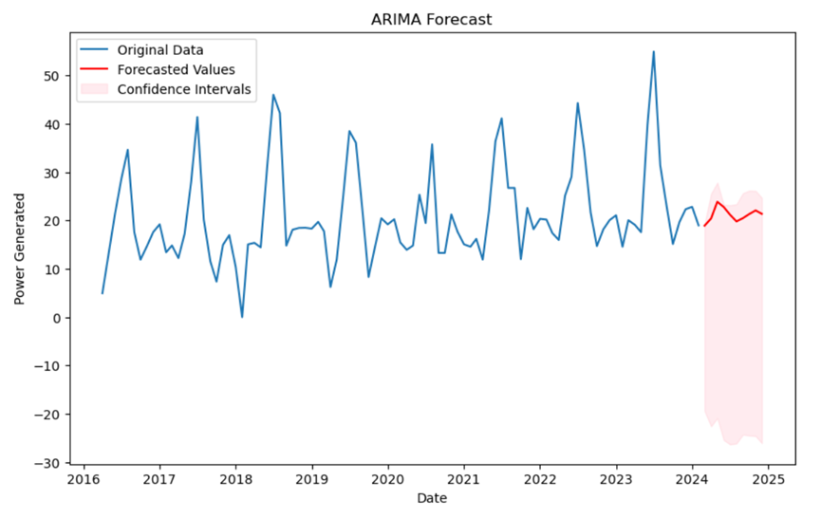
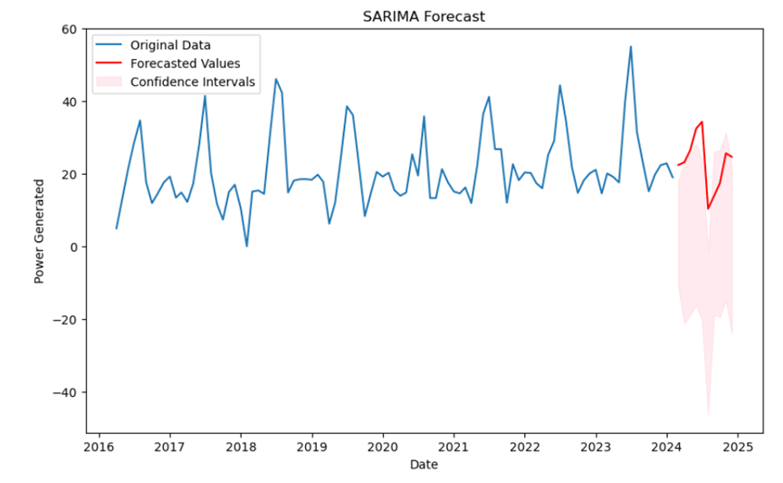
For renewable energy sources with distinct seasonal patterns, SARIMA models—an extension of ARIMA that takes seasonal variations in the data into account—further improve forecasting accuracy. Because of things like daylight hours and weather patterns, renewable energy generation—including solar and wind power—often shows seasonality. The order is denoted with (p,d,q) (P,D,Q) where the later term indicates seasonality.

Slide 12
XGBoost
XGBoost (Extreme Gradient Boosting) is a powerful machine learning algorithm that has shown remarkable performance in a wide range of prediction tasks, including renewable energy forecasting. XGBoost's ability to handle large datasets and optimize model performance through hyperparameter tuning further enhances its utility for renewable energy forecasting applications.
XGBoost creates a powerful predictive model by optimising a predetermined objective function and gradually adding weak learners (decision trees). Using the residuals—the differences between expected and actual values—of the previous model, a new tree is fitted in each iteration of the method with the goal of minimising the total prediction error.
XGboost uses the concept of regularisation (L1 and L2) , which is made up of a regularisation term and a loss function, in order to optimise the new tree model. The regularisation term penalises complicated models to prevent overfitting, while the loss function quantifies the difference between the actual target values and the predicted values.

Slide 13
Ensemble Model
An ensemble model is a machine learning approach that generates a final prediction that is more reliable and accurate by combining the predictions from numerous distinct models. By combining the predictions of several models, it takes use of the wisdom of crowds and frequently outperforms any one model used alone.
In this research, an ensemble model of Random Forest, Gradient Boosting, XGBoost has been used with Randomized search hyper parameter tuning. Ensemble models, including those built with Random Forest, Gradient Boosting, and XGBoost, work by combining the predictions of multiple base models (decision trees in these cases) to achieve better overall performance, robustness, and generalization.

Slide 14
GridSearch
In defining the grid we define the parameters with different values. Afterwards, you run k-fold cross-validation for every set of hyperparameters the grid contains. When a model is trained and assessed k times, utilising a different subset as the validation set and the remaining subsets as the training set, the training dataset is divided into k subsets. This technique is known as k-fold cross-validation. Based on the performance on the validation set, you choose the best set of the parameters and is used on the training dataset.
Randomized Search
Similar to Grid search, in random search also the first step is to define the search space and values of the parameters. But the main or significant difference between grid search and random search is the selection of combinations of parameters. Unlike grid search, Random search does not evaluate or go through all possible combinations of parameters. Instead, random search evaluates the combinations by selecting them randomly. The values are chosen randomly for each parameter within its specified range. After selection of this combinations, the steps are same as the ones which are performed in Grid search, and the best combination will be selected to train the model.

Slide 15
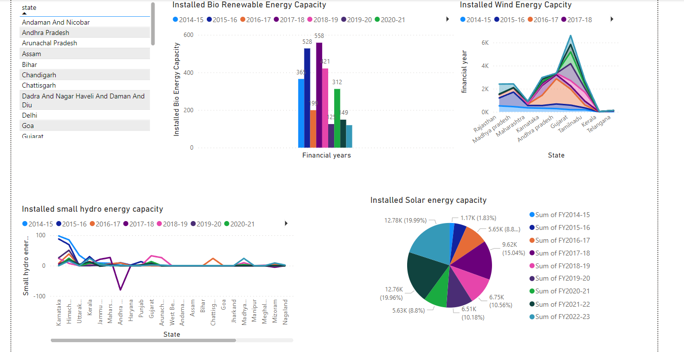
Visualization
Data Of Installed capacities of Renewable energy in India

Slide 16
Results and Conclusion
The traditional time series models ARIMA and SARIMA have been implemented first on the data of monthly power generation in the states of India by different forms of renewable energy like Solar, Small Hydro, Biomass, and Wind.
Later Machine learning model XGBoost with Gridsearch hyperparameter tuning and an Ensemble Model of Random Forest, Gradient Boosting, XGBoost with Randomized search hyperparameter tuning have been implemented on the same data.
The performances of these models have been compared to observe which model is giving a good forecast with better accuracy

Slide 17
The following table shows the sample results of all the models implemented on the Monthly power generation of Wind energy in the state of Telangana.
Metrics | ARIMA | SARIMA | XGBoost | Ensemble Model
Mean Squared Error (MSE) | 144.4804 | 91.5849 | 49.323 | 45.9142
Root Mean Squared Error (RMSE) | 12.02 | 9.57 | 7.023 | 6.776
Mean Absolute Error | 7.32 | 6.88 | 5.23 | 5.2

Slide 18
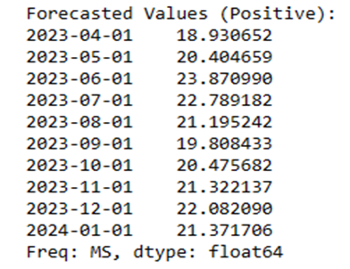
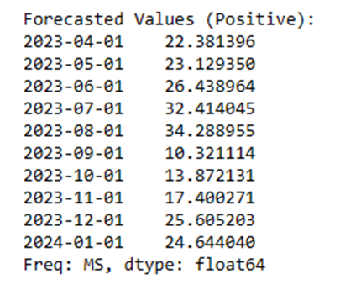
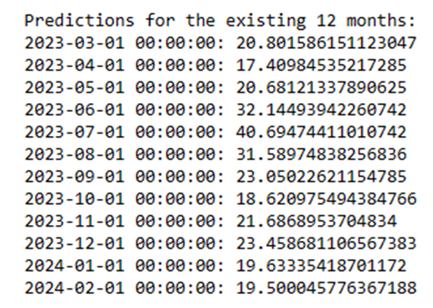
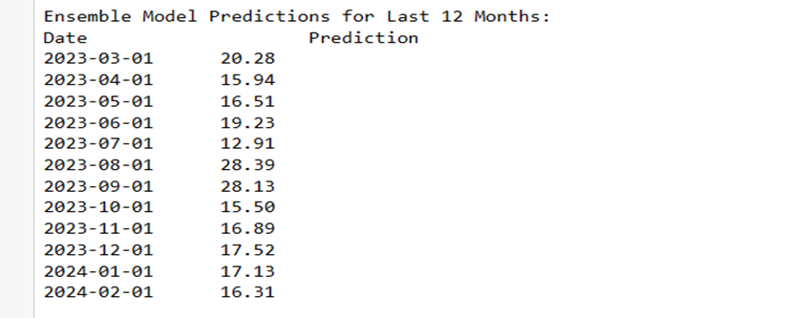
ARIMA
SARIMA
Ensemble Model
XGBoost

Slide 19
After comparing all the above models for forecasting this renewable energy generation based on the past monthly data of Solar, Wind, Small hydro and Bio mass energies, It has been observed that the ensemble model of the Random Forest, Gradient Boost and XGBoost gave a better result in the overall machine learning models and time series models where as Seasonal Autoregressive Integrated Moving average (SARIMA) gave better results compared to ARIMA in the traditional time series models alone. So, the forecast obtained through these models can be used for further analysis and actions.

Slide 20
Future Scope
Deep learning models like Recurrent Neural Networks (RNN) namely Long Short-Term Memory (LSTM) and advanced models like FB Prophet etc can also be used for further analysis or comparison with the above tested models. But the main result or focus of all these models is to forecast the demand of the power generation through renewable energies. This demand forecast can be used to develop plans to increase the capacities of the renewable energy plants in the respective states. And also the effect of various factors in the energy production from these renewable energy sources can also be studied and analysed as that also plays a major role in the power generation and its demand.

Slide 21
References
A Review of deep learning for renewable energy forecasting by Huaizhi Wanga, Zhenxing Leia, Xian Zhangb, Bin Zhouc, Jianchun Penga,2019.
The future of forecasting Renewable energy by Conor Sweeney1,2 | Ricardo J. Bessa3 | Jethro Browell4 | Pierre Pinson5, 2019.
A deep learning -based forecasting model for renewable energy scenarios to guide sustainable energy policy: A case study in Korea by KiJeon Nam a,1, Soonho Hwangbo b,1, ChangKyoo Yoo a , 2020.
Multi-aspect Renewable energy Forecasting by Roberto Corizzo , Michelangelo Ceci , Hadi Fanaee-T , Joao Gama ,2020.
Future Scope of Solar Energy in India by Bharat Raj Singh and Omkar Singh, 2016.
Spatial Autocorrelation and Entropy for renewable energy forecasting by Michelangelo Ceci , Roberto Corizzo, Donato Malerba, Aleksandra Rashkovska, 2019.
Towards Data Markets in Renewable Energy Forecasting by Carla Goncalves,Pierre Pinson, Ricardo J. Bessa , 2020

Slide 22
Thank You
reallygreatsite.com

